Slide 1




Asp.Net Mvc Workshop James Chambers @CanadianJames james@jameschambers.com http://jameschambers.com

Slide 2
Expectations

Slide 3
Concepts - MVC
Model and View mitigation through Controller
View represents output and possibly user interaction with model
Model is the domain
Properties
Logic & Rules
Manipulation
Persistence
@CanadianJames # AspNetMvc

Slide 4
Concepts - Actions
Operations performed on Controller
Invoked to generate some kind of output
Html View
JSON
Binary types (boo!)
@CanadianJames # AspNetMvc

Slide 5
Concepts - Scaffolding
Easy “site” generation
Headstart on CRUD
ORM Options
Freedom to drop/recreate
1985-like conformity
@CanadianJames # AspNetMvc

Slide 6
Concepts - Routing
Configured in App_Start, lives for application
Syntax is not RegEx
Greedy
@CanadianJames # AspNetMvc

Slide 7
Concepts – Model Binding and Serialization
Support POCO, JSON, XML others
Can support complex scenarios
Lists
Checkboxes
@CanadianJames # AspNetMvc

Slide 8
Concepts – Deployment
Directly from Visual Studio 2012
Through Windows Azure PowerShell cmdlets
From Source Control Deployments
This is the shiznit!
@CanadianJames # AspNetMvc

Slide 9
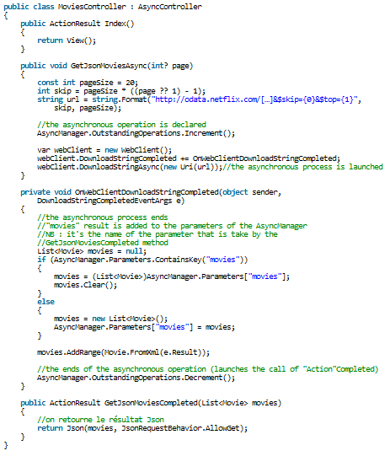
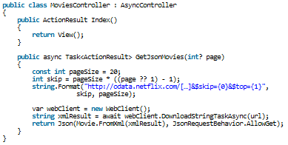
Asynchronous Controllers
@CanadianJames #AspNetMvc

Slide 10
Next Steps
File -> New -> Project!
Build some stuff, make some mistakes
Connect on Twitter
#aspnetmvc
#nuget
@CanadianJames # AspNetMvc

Slide 11
Moar Sessions
Why OData ?
Here, now, Mark Stafford (MSFT)
What do you do with Windows Azure Websites
After Mark, same room, Tyler Doerksen (Azure MVP)
Entity Framework Migrations
Viscount B, 9:30 AM tomorrow, Dave Paquette
@CanadianJames # AspNetMvc

Slide 12
Environment Prep
Install MVC4 through Asp.Net/Mvc
Get a GitHub Account if you don’t have one
Download GitHub for Windows
Fork the Repo (MisterJames/MvcMovieFu)
@CanadianJames # AspNetMvc

Slide 13
Cool. Time to code.

Slide 14
Thanks!
James Chambers
james@jameschambers.com
http://jameschambers.com/blog
@CanadianJames
GitHub: MisterJames

